Slide 1


Prediction of Pricing in Airbnb listings around Boston
Attreyee Banerjee Ernesto Contreras Moitreyee Banerjee Jayashree Jayashankar
Sriram Ramanujam Sivasundari Sundaram Vishal Vatnani

Slide 2
Agenda
Introduction
Question of Interest
Data Cleaning
Methods Used
Comparison & Interpretation
Conclusion

Slide 3
Introduction
Airbnb is an online marketplace and hospitality service, enabling people to lease or rent - short term lodging including vacation rentals, apartment rentals, homestays, hostel beds or hotel rooms

Slide 4
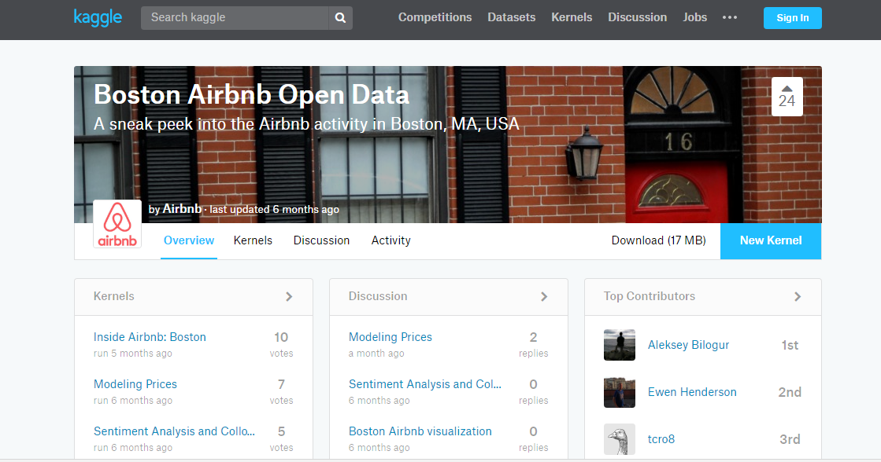
Data source
Dataset is obtained from Kaggle.com – Boston Airbnb
https://www.kaggle.com/airbnb/boston

Slide 5
Question of Interest
Target Variable: Price
Question: What are the factors that determine the pricing of the accomodations listed at Airbnb?
Data Mining Methods Used: Prediction-CART, Knn, MLR and Cluster Analysis

Slide 6
Let’s have a nice look at the data

Slide 7
https://public.tableau.com/profile/publish/Book3_5020/Dashboard1#!/publish-confirm

Slide 8
Expanding the Dataset

Slide 9
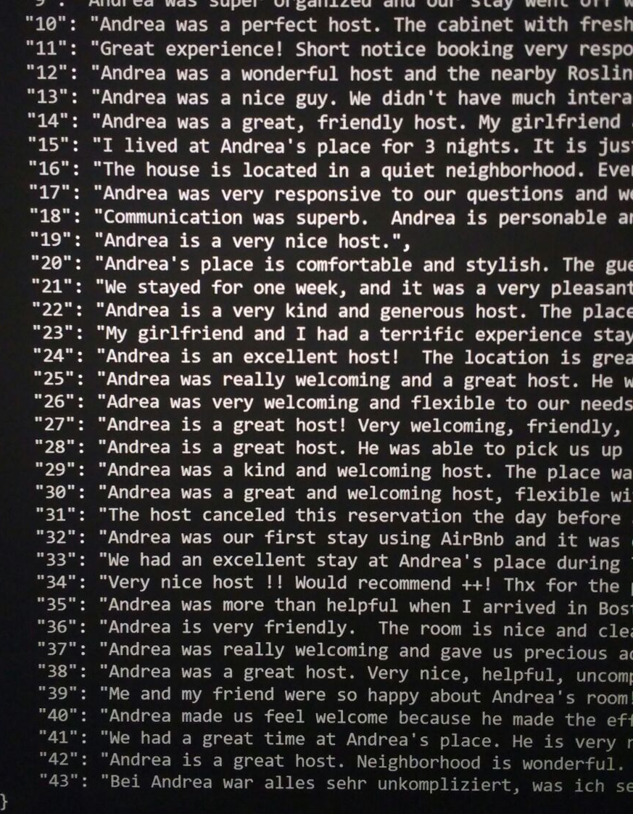
Crawling the Airbnb API

Slide 10
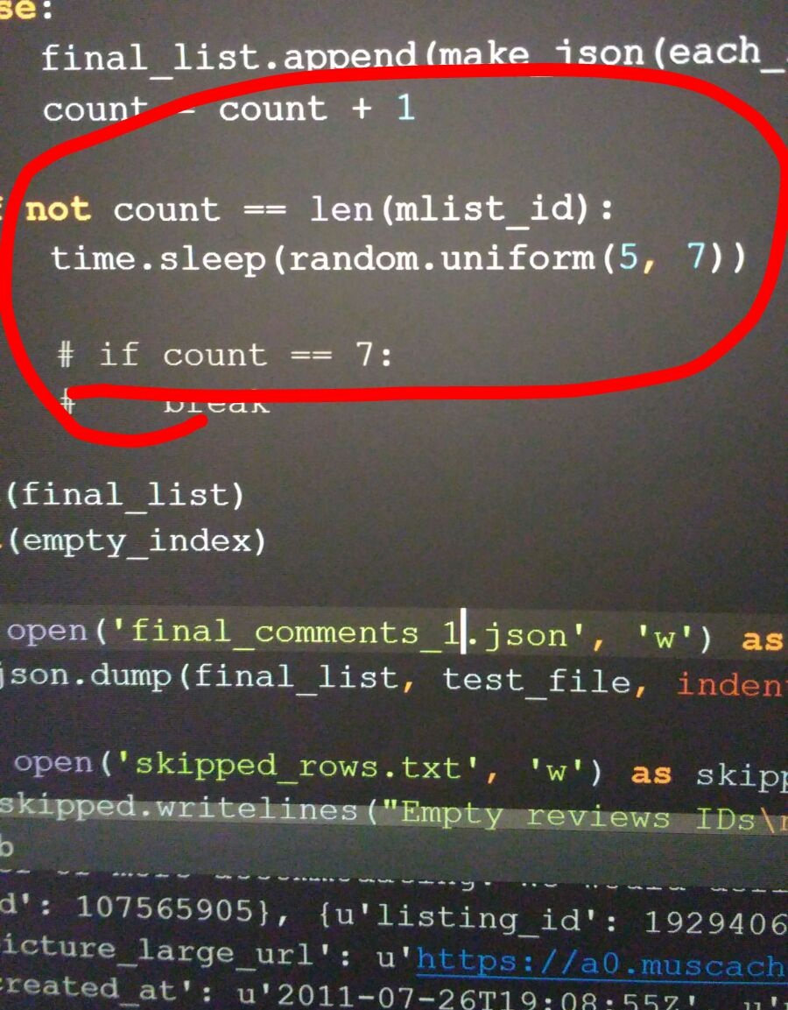
Crawling the Airbnb API

Slide 11
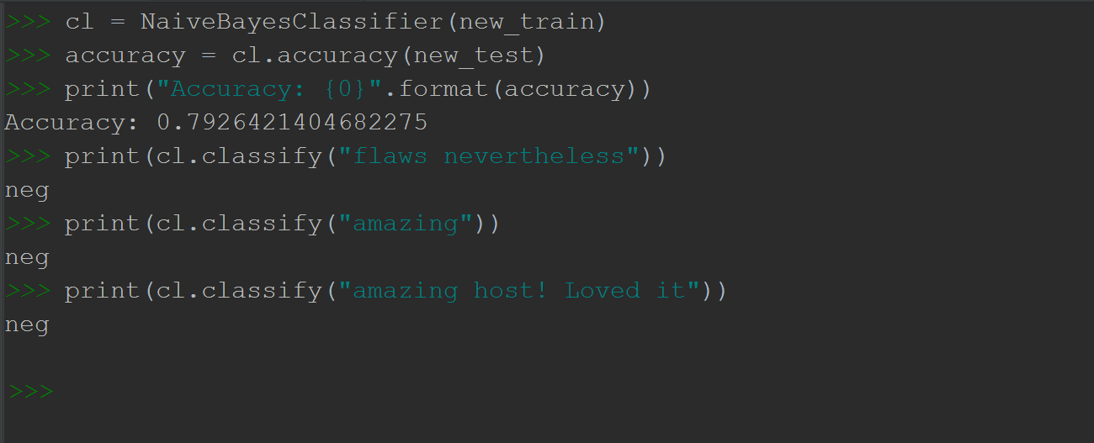
Sentiment Analysis

Slide 12
Maybe next time

Slide 13
Dataset Cleaning
Identified the variables required and removed the irrelevant ones
Using R , we cleaned the remaining data, Identifying outliers and missing values.
We had Categorical Variables and converted them to dummy variables.
Finally we got the dataset with 49 dependent variables and Price

Slide 14
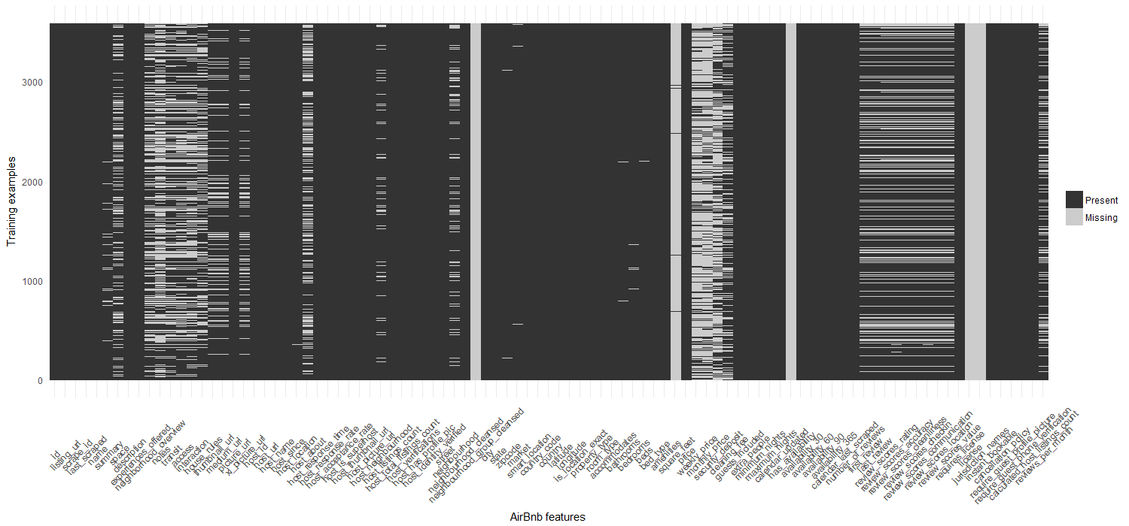
Heat Map showing Missing values

Slide 15
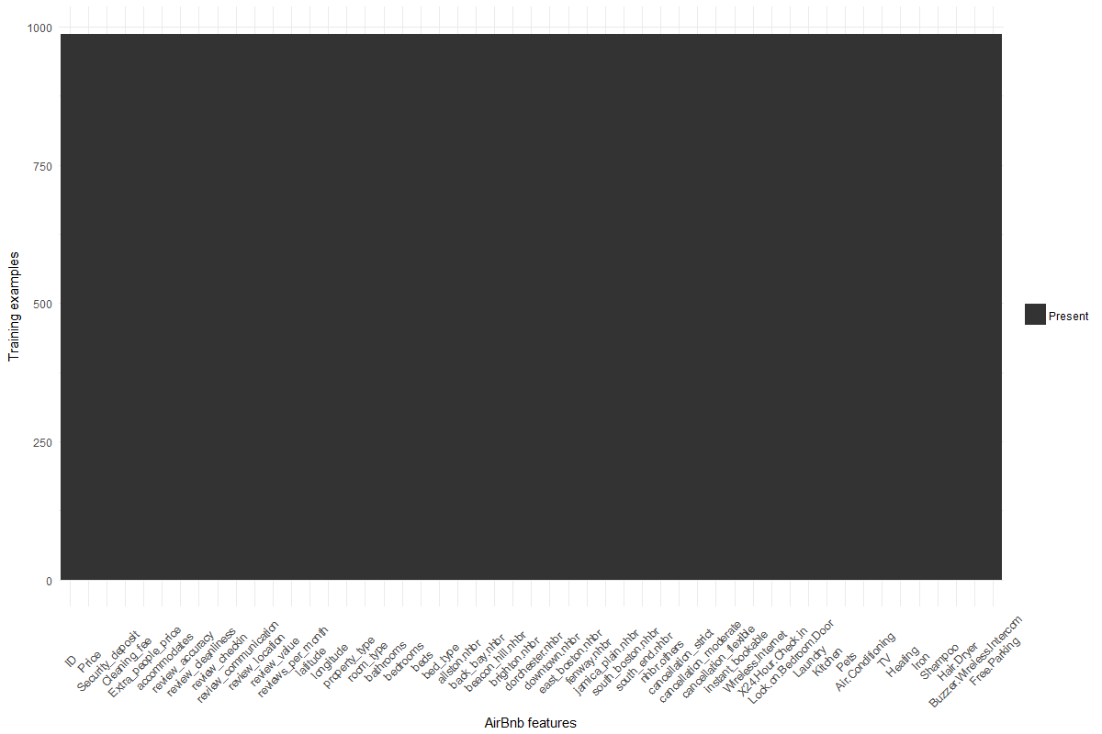
Heat Map of the cleaned Data

Slide 16
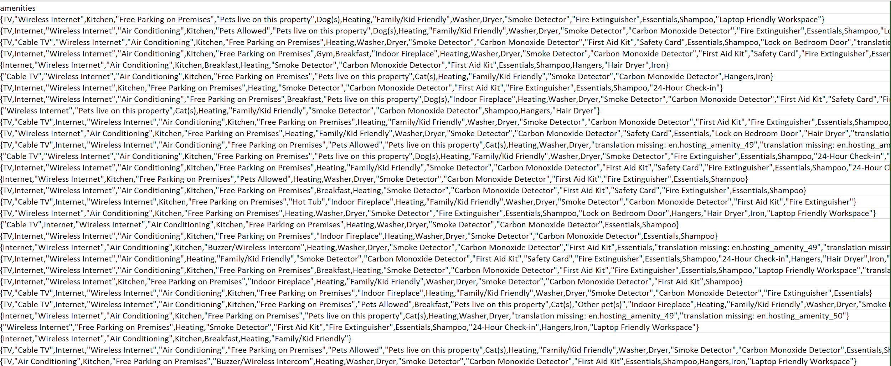
The amenity feature

Slide 17
The frequency plot
http://lab.vatnani.com/pyplot.html

Slide 18
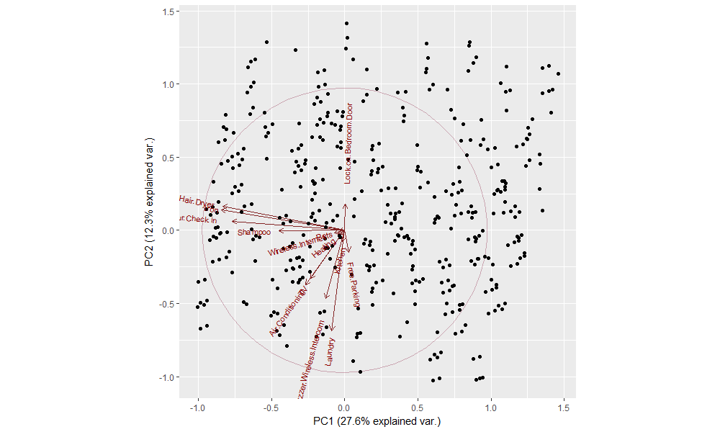
PCA analysis on the features

Slide 19
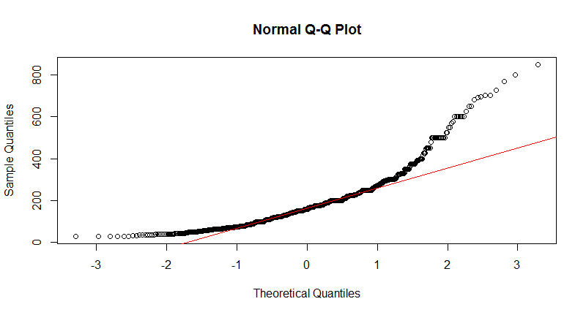

Slide 20
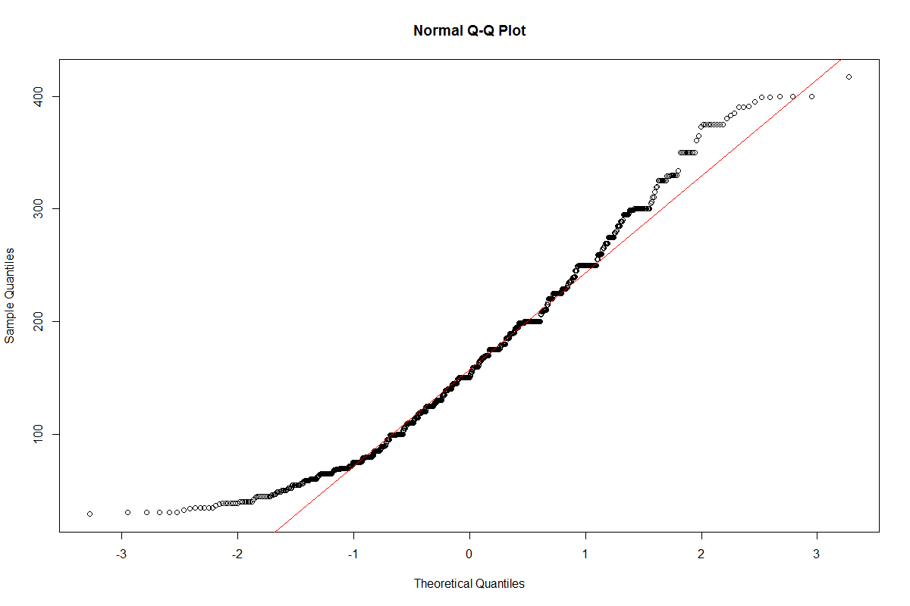

Slide 21
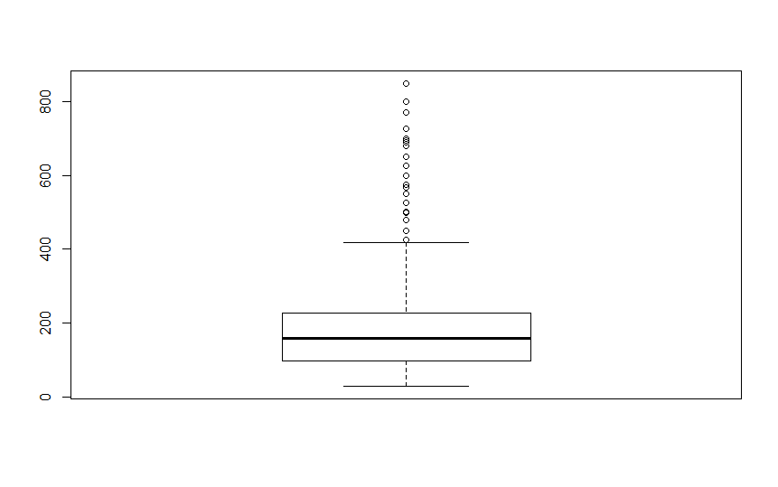
Price Before cleaning

Slide 22
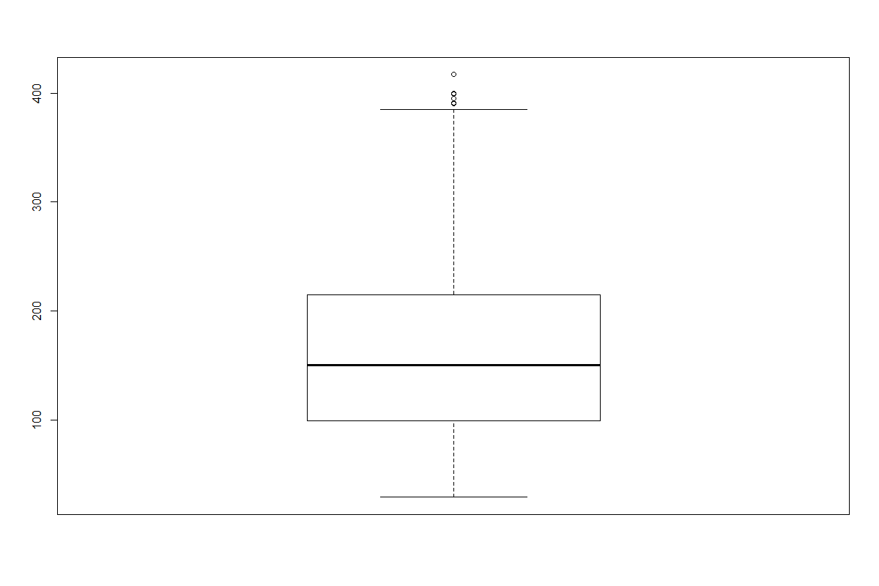
Price after cleaning

Slide 23
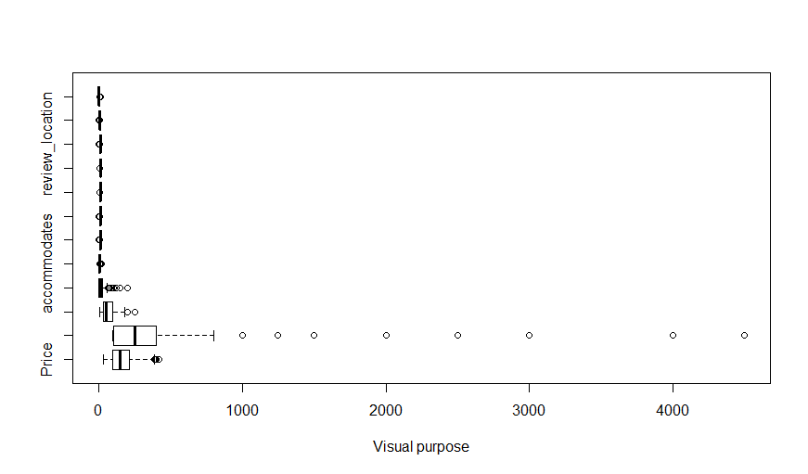
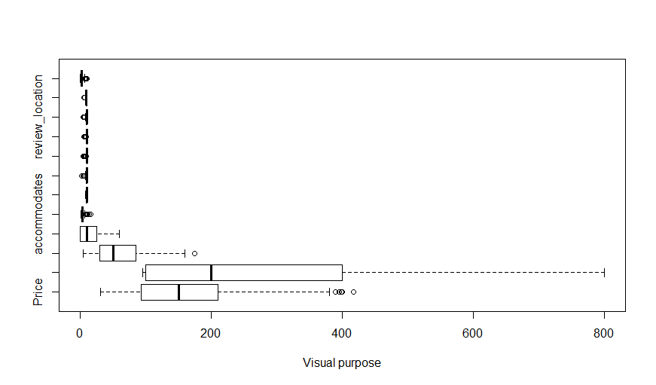

Slide 24
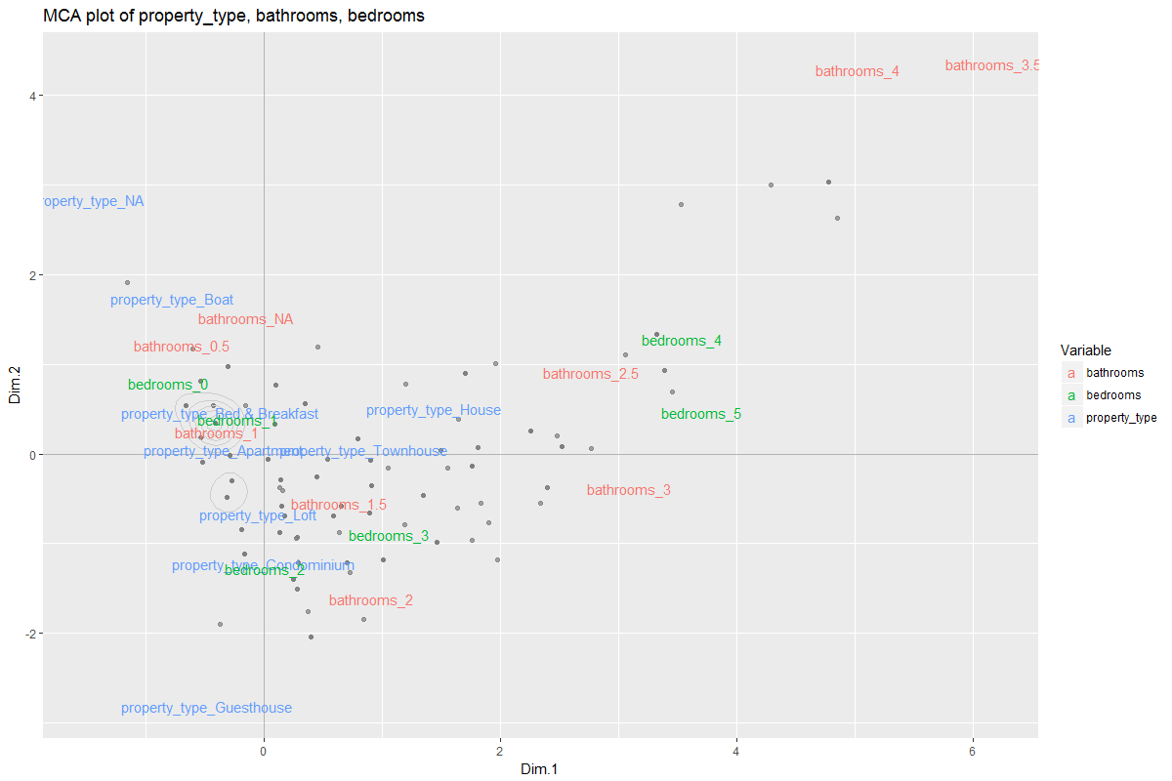

Slide 25
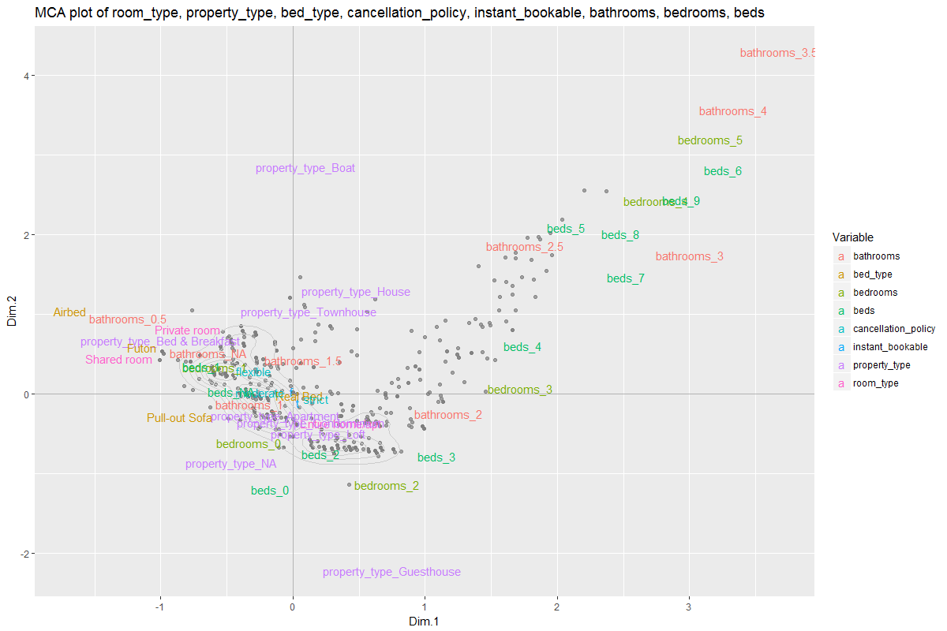

Slide 26
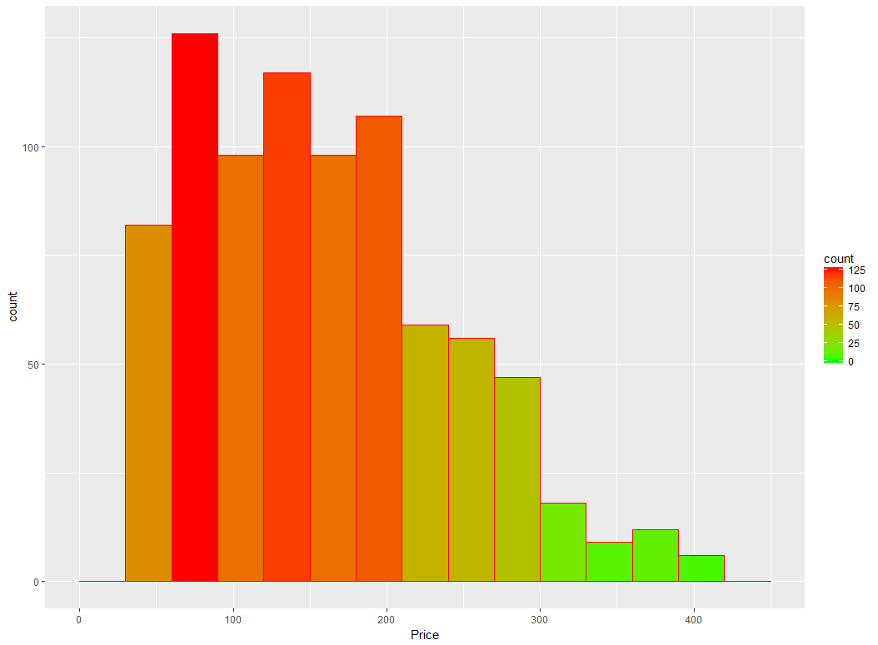
GG Plot for Price

Slide 27
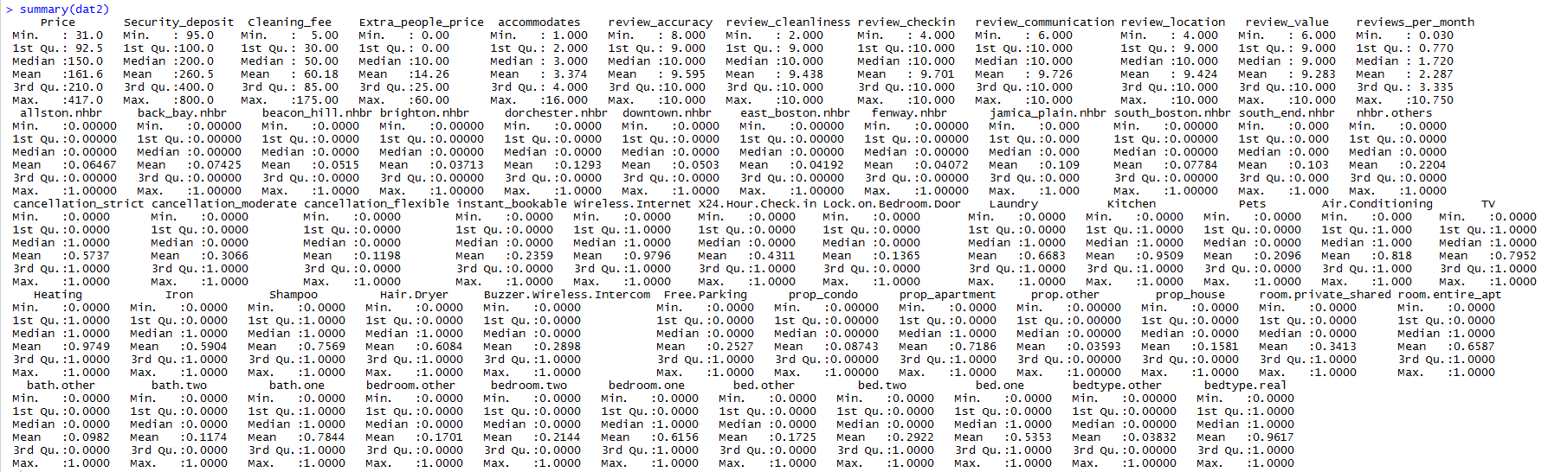

Slide 28
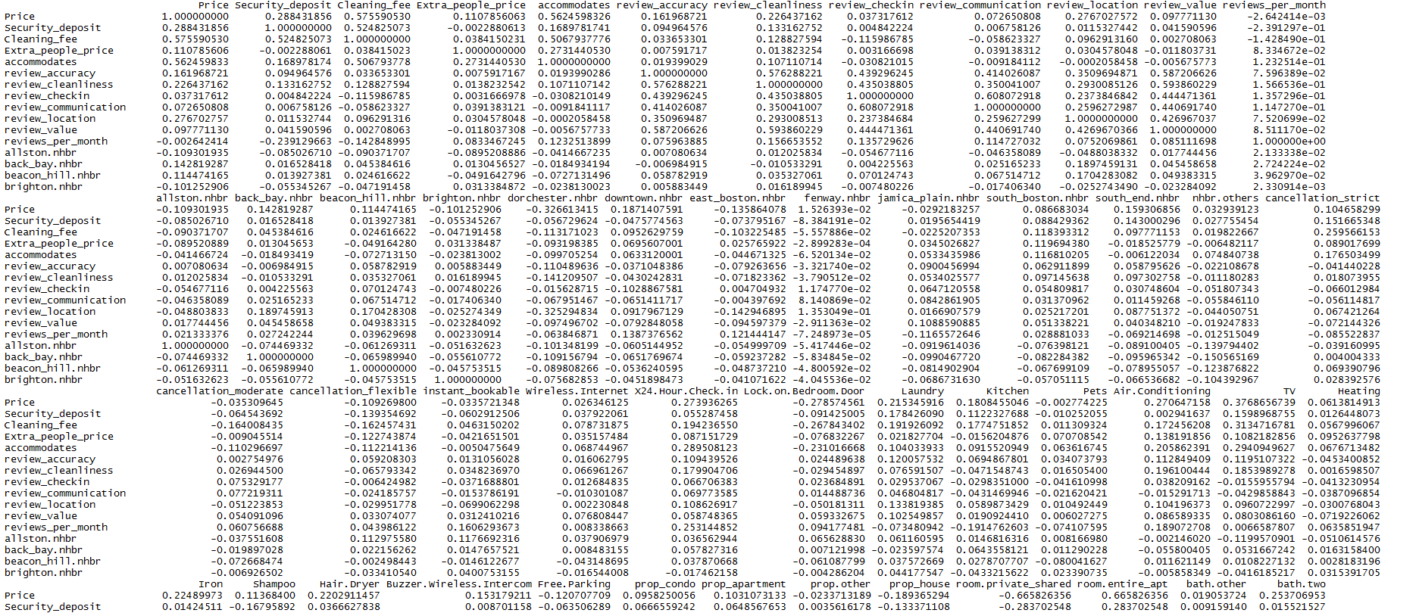

Slide 29
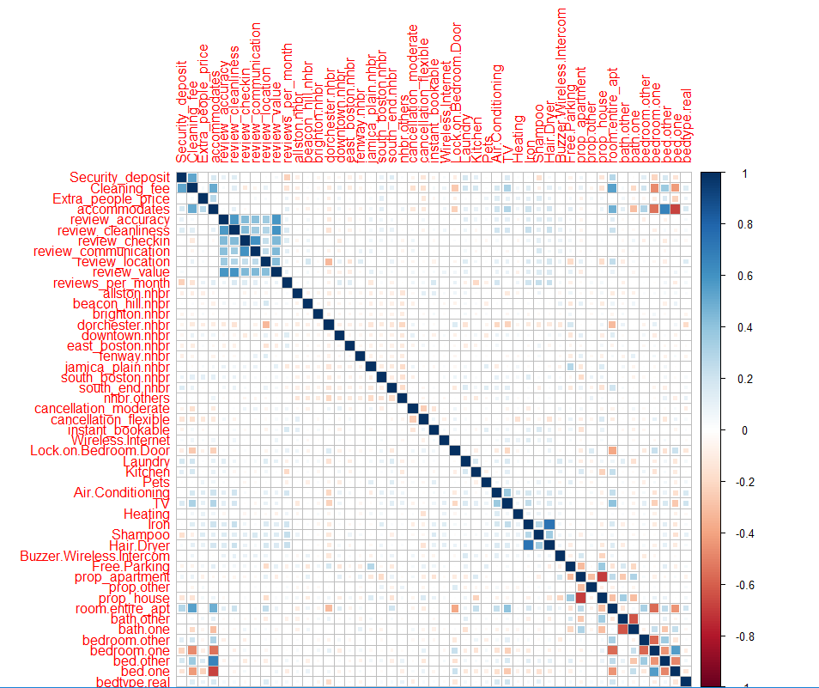
Correlation
Matrix:

Slide 30
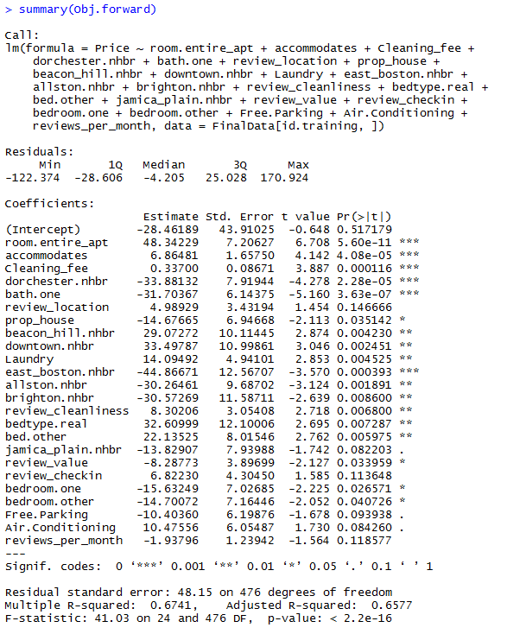
MLR - Forward Selection

Slide 31
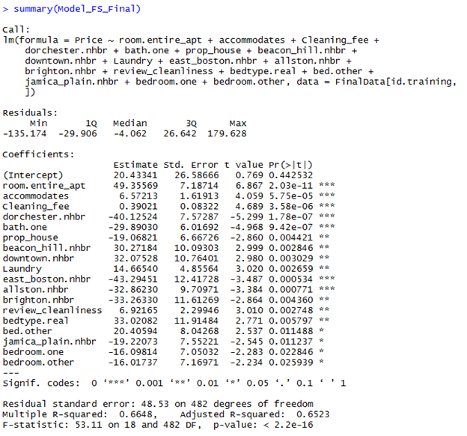
MLR - Final Model and RMSE

Slide 32
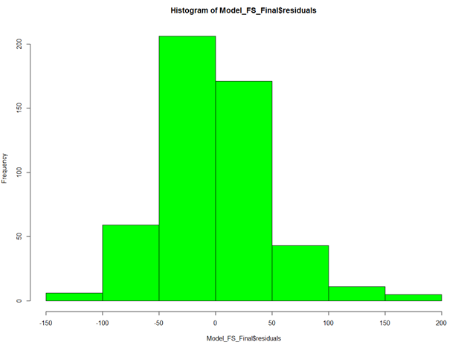
Normality of Residuals Assumption

Slide 33
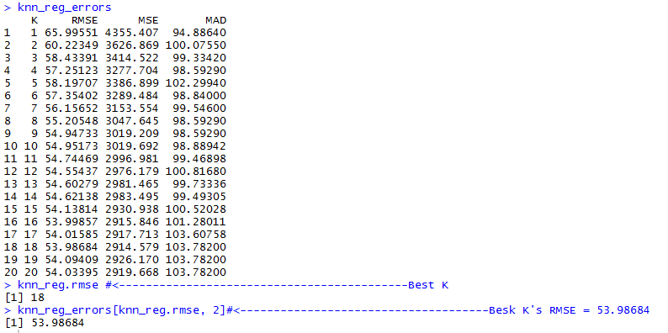
KNN

Slide 34
KNN visualization
http://lab.vatnani.com/knn.html

Slide 35
KNN visualization on three features with the selected k
http://lab.vatnani.com/clusterOnThree.html

Slide 36
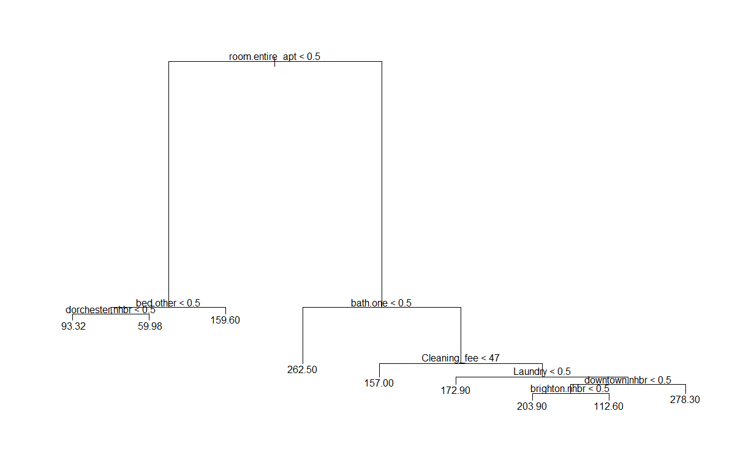
CART - Fully grown Tree

Slide 37
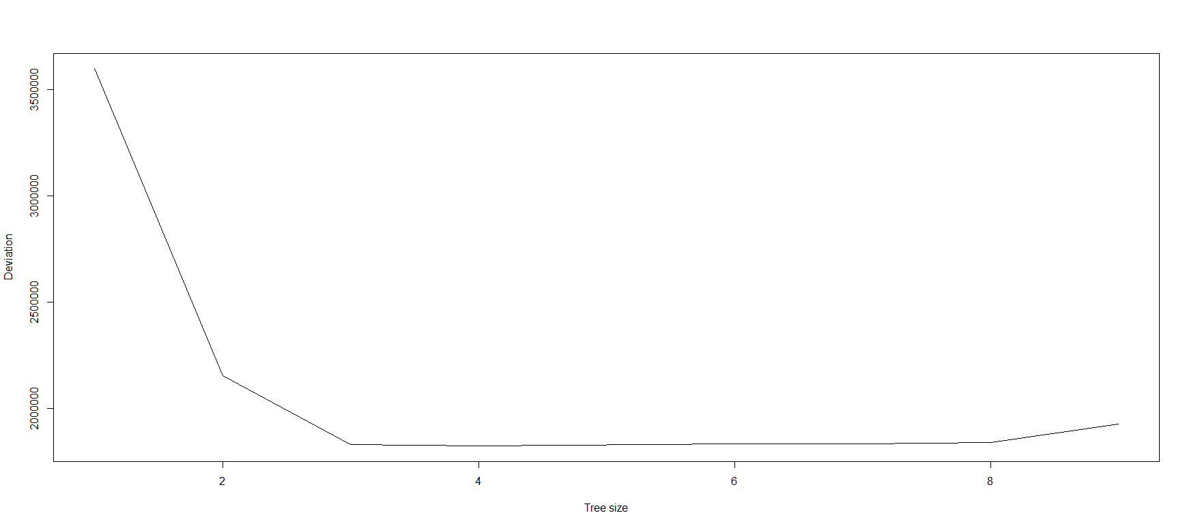
Cross-validation

Slide 38
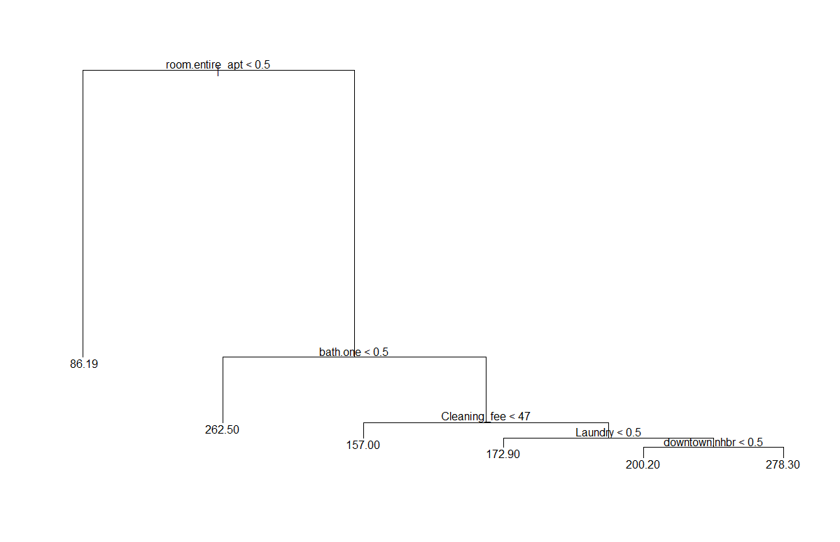
Best Pruned tree

Slide 39
CART- Result
Regression Trees RMSE Values
Fully Grown Tree | 52.24
Pruned Tree | 51.72

Slide 40
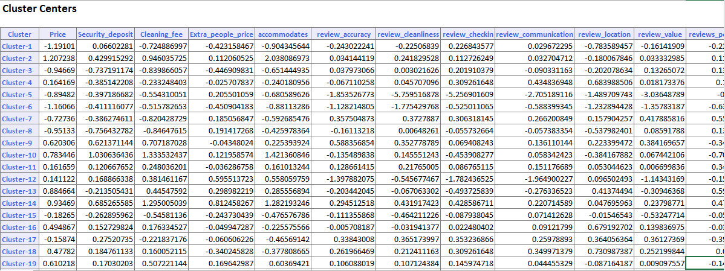
Cluster Analysis - k-Means (All attributes)

Slide 41
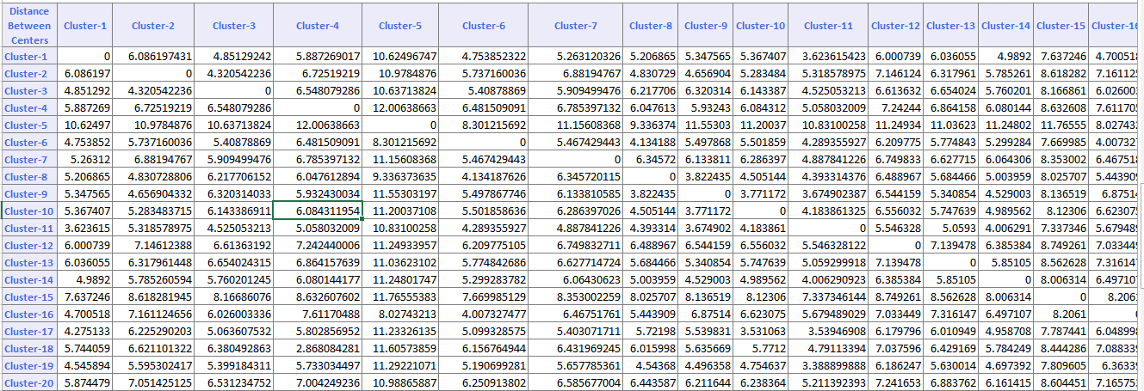
Cluster Analysis - k-Means (All attributes)

Slide 42
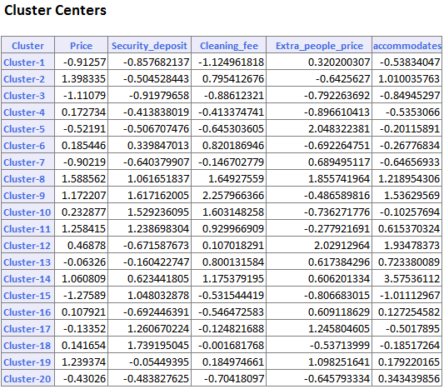
Cluster Analysis - k-Means (5 attributes)

Slide 43
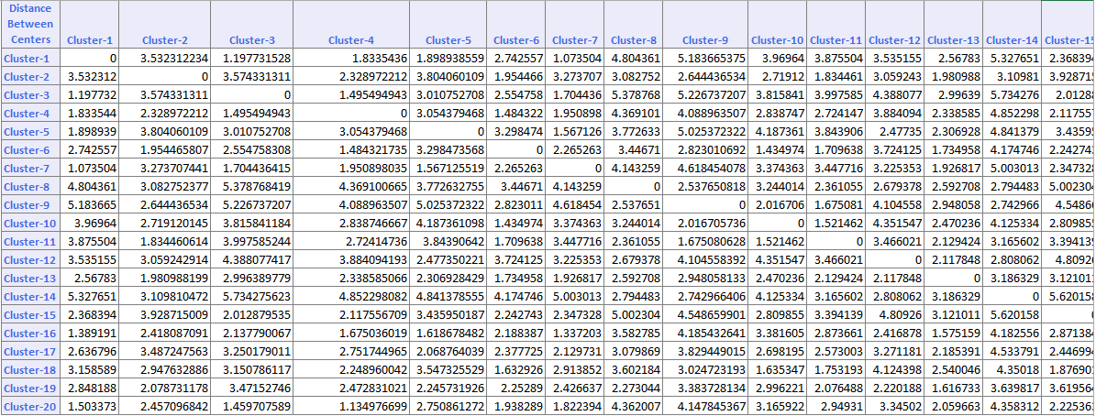
Cluster Analysis - k-Means (5 attributes)

Slide 44
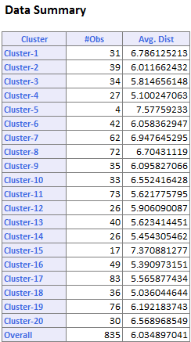
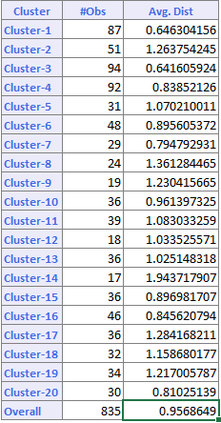
Cluster Analysis - k-Means (All vs. 5 attributes)

Slide 45
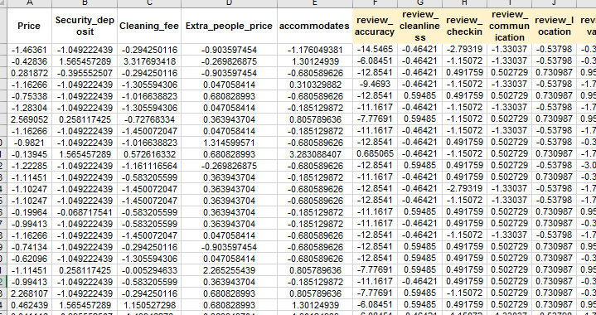
Cluster Analysis - Dendrogram Input

Slide 46
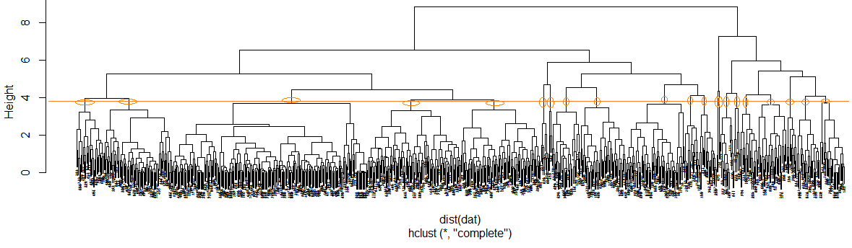
Cluster Analysis - Dendrogram

Slide 47
Comparison and Interpretation
Model | RMSE
Multiple Linear Regression | 51.12
Regression Trees | 57.97
k-Nearest Neighbors | 53.22

Slide 48
Conclusion
We had 38 dummy variables in our dataset and 11 continuous variables
In the end we had to choose a method as the defective one it would be very close between MLR and CART.
We have decided to choose MLR method as it contains 18 variables.
The multiple regression model built using 15 predictors is chosen as the best model for predicting the “Pricing” in Airbnb

Slide 49
Thank You!

Slide 50
Questions?

